Slide 1
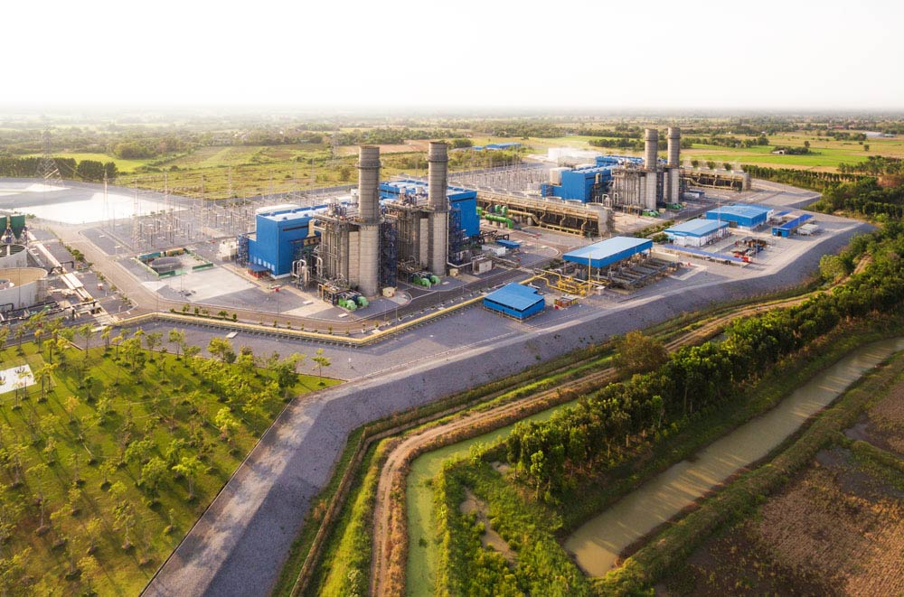
Gulf Energy Development
2018 Business Plan

Slide 2
2017 Key Achievements
Applications to support Business Process
Financial BI dashboard: Gulf financial performance accessible by Management team on mobile platform
HR Recruitment Enhancement: Major improvement on HR requirement process; Mobility platform accessible by candidates and recruiters at anytime by any devices. Also improvement on end-to-end hiring process for our HR team.
CRM (Customer Relationship Management): System to manage relationships of our key stakeholders depicting their demographics, preference, activities with Gulf and network.
QR Code system for Inventory and Fixed Asset: Digitally transformed process from manual to QR code automation to improve turnaround time, accuracy, compliance and overall end-to-end process
In-house development of application: started in 2017, In-house development is proven to be quick and effective approach for some of the application
E-Bidding
E-Reservation
Contracted staff assessment
New Year Gift system
Intention Form for IPO offering
Intranet: Internal landing page for information, news, update and knowledge hub.
SAP Implementation on Solar Projects
K2 Implementation for 12 SPPs
Collaboration Tools
IPTEL: Major improvement on future-proof telephony system with better performance and much less costing model.
Video and Audio Conference: platform set up to support remote conference to reduce cost and promote productivity of time saving.
Wireless Screen Sharing (BARCO): Installed in all meeting room to provide convenience to any devices.
Workplace: New approach of two-way communication tools to promote interaction of all level of employees.
Infrastructure and End-user Support
Excellence in service: Average of more than 95% for Service Level Agreement and Customer Satisfactory.
Server and network Availability: Less than 0.XX% down time thru out the year.
New plants and Head Office IT Infrastructure: Scalable, Future Proof and cost effective design
Audit and Compliance
Audit and IPO: Successful compliance on all audit both internal and external, also IPO process preparation.

Slide 3
2017 Key Achievements
 |  | Creating new business solution | Simplifying existing process | Reducing turnaround time | Mobility Available | Improving Service Availability | Cost Saving | Risk Reduction and improving Compliance | Rectifying or Mitigating issue.
 | Financial BI dashboard
 | HR Recruitment Enhancement
 | CRM (Customer Relationship Management):
 | QR Code system for Inventory and Fixed Asset:
 | In-house development of application
 | Intranet
 | SAP Implementation on Solar Projects
 | K2 Implementation for 12 SPPs
 | IPTEL
 | Video and Audio Conference
 | Wireless Screen Sharing
 | Workplace
 | Excellence in service
 | Server and network Availability
 | New plants and Head Office IT Infrastructure
 | Audit and IPO

Slide 4
2018 Business Plan

Slide 5

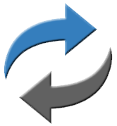

Department’s Vision
Corporate Vision / Mission:
“A trusted company that innovates to develop premier energy across boundaries”
“To integrate innovative strategy, quality resources, premier technology and culture of commitment to achieve the most reliable energy solution”
Department’s
Vision to
Support Corporate Vision
Other Departments’ Visions
Trusted and recognized as a key business partner who proactively and efficiently supports Gulf business objectives through;
Innovation:
Exploiting technology where it matters to drive Gulf business
Transformation:
Digitally transform the organization to improve business plan and achieve objectives
Execution:
Execution with right capability, mindset and expertise

Slide 6
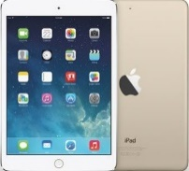
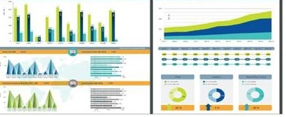
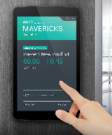
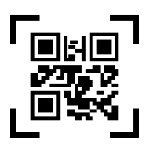
Action Plan to Support Gulf’s Growth
Growth
Digital Transformation
Drive the potential digital approach to enhance the effectiveness and efficiency of business processes where appropriate. And at the same time prepare the readiness of the organization to cope with fast-moving changes of digital environment
Mobility for all financial transactions where all of approval for financial transactions
can be made at anywhere any time thru mobile devices on Gulf applications.
APM (Asset Performance Management)
Study the potential for digital transformation on AMD to make use of
data and IoT (Internet of Thing) approach to create predictive analysis
to improve Reliability, Cost and Risks.
Process improvement and Simplification
Continuous improvement and simplification on existing and/or new potential solutions.
Potential Financial and Investor relations Dashboard improvement
Digital touchscreen room booking solution.
HR mobility.
QR code or similar to replace manual process, where possible
Remote meeting thru Video and Audio Conference
Risk
Finance
People
Society

Slide 7
Action Plan to Support Gulf’s Growth
Growth
Continuous Improvement on critical systems
Customer Relationship Management enhancement on the system based on the comments from the users after launch
Document Management System enhancement on the system to better cope with managing and handling documents for engineering team.
Risk
Finance
People
Society

Slide 8


Action Plan to Support Gulf’s Growth
Growth
Risk management and Compliance Control
Compliant with all Audits internally and externally.
Annually revise and perform the Disaster plan and recovery test.
Up-to-date risk management plan for the department with risks and
mitigation plan identified for IT Process, Hardware, Software and Network
Licensing control
Scheduled data back up
Network firewall
Risk
Finance
Penetration test (external hacking test)
For all critical systems, IT to perform annual penetration test by certified
external vendors, and rectified if needed, to ensure the maximum security
of Gulf critical and proprietary information.
People
Network enhancement
To ensure the minimum downtime, avoid the single point of failure of Gulf network by re-designing the infrastructure to cope with growing in number of plants and the consumption of bandwidth.
Society

Slide 9
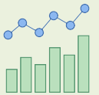
Action Plan to Support Gulf’s Growth
Growth
IT Costing rationalization
Seek the possibility to reduce IT expenses but, at the same time, maintain or improve the effectiveness of process and services.
Cloud computing for non-confidential Gulf systems and services: to migrate some of the non-confidential system/services to certified cloud environment to save cost, time and improve end-to-end process to manage.
Potential cost saving through Vendor’s rationalization Build the strong In-house application development in Gulf IT to support the growth of the company and at the same time reduce the cost and time as opposed to hiring vendors.
Potential cost saving through Device’s life span extension.
Risk
Finance
Continuous support on IT-related matters to IR
Support any related data or technical tools and technology on IR
Compliance on Audit for IR
People
Society

Slide 10

Action Plan to Support Gulf’s Growth
Growth
Continuous development on IT key Capabilities
Drive performance of IT team through the Capability redesign for 2017 (IT-Refocus 2017), Shifting from service mindset to all 5 key pillars of Capability design
Risk
1 Strategize: Deliver strategies to enable the Gulf Business on Key strategies and ambitions
2 Engage: Partnering with key stakeholders to drive the changes of IT initiatives
3 Engineer: Create/ develop solutions for business based on defined processes.
4 Deliver: End-to-End process and understanding of project lifecycle and management
5 Service: Excellence in service delivery to achieve the best result and customer feedback
Finance
Development plan for IT individual and Network of Sharing
Clear development plan for IT individual both technical and non-technical skills and promote Network of sharing internally and externally (Group of IT super users )
People
Centralization of IT officers
To improve the effectiveness and efficiency of IT officers to better serve the organization by adjusting the org chart where IT officers will dotted-line report to IT HQ (with 30-50% KPI setup and evaluated)
Society

Slide 11
Action Plan to Support Gulf’s Growth
Growth
Corporate CSR
Encouragement and support from IT department for employees to join the Corporate’s CSR programs and potentially bring in IT expertise to support the programs.
Risk
Finance
People
Society

Slide 12
Proposed 2018 KPI
No | Goals | Weight | Threshold | Target | Outstanding
1 | Mobility for all Financial approval system. | 15% | Completed within Aug-18 | Completed within Jul-18 | Completed within Jun-18
2 | AMD Mobility Dashboard and Analytics | 15% | Completed within Nov-18 | Completed within Oct-18 | Completed within Sep-18
3 | Implementation of Applications to support business process of various departments | 30% | 80% Completion according to timeline of business owners | 85% Completion according to timeline of business owners | 90% Completion according to timeline of business owners with more than 90% of user satisfaction
4 | Service SLA and Customer Feedback (VOC) | 20% | 80% of Service Level Agreement and less than 20% negative voice of customer | 85% of Service Level Agreement and less than 15% negative voice of customer | 90% of Service Level Agreement and less than 10% negative voice of customer
5 | IT Infrastructure improvement with improvement on cost effectiveness | 10% | Successful Implementation of new infrastructure within Sep-18 | Successful Implementation of new infrastructure within Aug-18 | Successful Implementation of new infrastructure within Jul-18 with improvement on cost effectiveness

Slide 13
Proposed 2018 KPI
No | Goals | Weight | Threshold | Target | Outstanding
6 | Audit, Compliance | 5% | N/A | Rectification of all findings from Audit, Compliance within timeline | Rectification of all findings at least 1 months prior to timeline
7 | IT Security testing by certified external vendor | 5% | Rectification of all findings within Oct-18 | Rectification of all findings within Sep-18 | Rectification of all findings within Aug-18

Slide 14
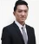
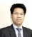

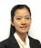
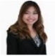
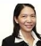
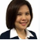
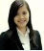
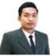
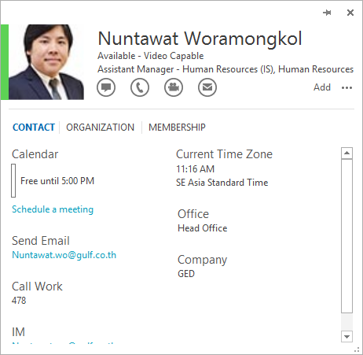

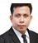
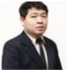
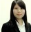
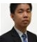
2018 Internal Resource Allocation (RACI Chart)
Resource Allocation 15 Total headcounts |  | Aticha A. SVP, Head of IT | Ply S. VP, Infra / End User | Surachai S. AVP App Support | Thanatip N. Senior IT Admin Officer | Sakulrat T. Project Manager | Sunonthacha P. ERP Business Analyst | Methawan S. ERP Business Analyst | Suveecha P. System Developer | Preecha J. System Developer | Nuntawat W. System Analyst / Support | Khomkorn K. System Administrator | Suwatchai K. System Administrator | Somnuek H. Network Engineer | Suleeporn C. IT Support | Poempon S. IT Support
 | IT Strategy
 | IT Compliance and Audit
 | IT Project Management
 | IT Budget
2018 Projects | Mobility for Financial Transactions
 | AMD Dashboard
 | Digital Touchscreen for meeting room
 | Infrastructure cloud
 | SAP for GEC group
 | IT Security Test
 | Other IT In-house Applications
Enhancement | CRM Enhancement
 | HR Recruitment/Learning Enhancement
 | Video Con Adoption
 | Finance BI |  |  |  |  |  |  | A/R
 | DMS
 | Inventory/Asset Management
 | External Website
 | Intranet and Content Management
Service Mgt. | Infrastructure Management
 | DMS and engineer system
 | SAP and other FIN systems
 | HR System Management |  |  |  |  |  |  |  |  |  | A/R
 | Service Management
 | IT Communication
 | IT Administration/Purchasing |  |  |  | A/R
Responsible (Assigned to do the work) Accountable (Ultimate ownership) Consulted (before decision is taken) Informed

Slide 15








IT Project Management Role Swim lane
Roles | 1. Initiating | 2. Planning | 3. Executing |  | 4. Closing
IT Project Lead | Initiate idea and Complete Project Charter and send to IT head | Support Project Manager on Planning Phase | Oversee the execution |  | Change Management | After Action Review and Enhancement plan, if needed
IT Project Team |  |  | Complete business requirement | Complete Implementation then create test Scenario | Hand over to service team, user manual, and IT system Spec | Early life Support
IT Project Manager |  | Project update, tracking and escalating (if needed)
 | Kick-off Project with Steering and project team | Set up Project Plan with (Resources, Scope, Time and cost) vendor selection, if needed | Kick off Execution phase |  | Prepare go-live
Business Team |  |  | Provide requirement | Test the system
Business Lead |  |  | Sign-off requirement | Sign-off UAT | Approve go-live
Steering Committee/ IT head | Approve | Approve | Attend Steering Committee

Slide 16






IT Capability to support Vision
Trusted and recognized as a key business partner who proactively and efficiently supports Gulf business objectives through;
Innovation:
Exploiting technology where it matters to drive Gulf business
Transformation:
Digitally transform the organization to improve business plan and achieve objectives
Execution:
Execution with right capability, mindset and expertise
5 Key Capabilities
03 Engineer
Create/ develop solutions for business based on defined processes.
Technical Design and Programming
01 Strategize
Deliver strategies to enable the Gulf Business on Key strategies and ambitions
05 Service
Excellence in service delivery on all IT related.
Tickets Management (ITLT standard)
02 Engage
Partnering with key stakeholders to drive the changes of IT initiatives
Stakeholder Mapping
Governance Model
04 Deliver
Project Manage, Develop project plans specifying goals, deliverables, resources
Project Methodology
Timeline and resources

Slide 17
Digital Transformation
Digital Transformation |  | Traditional | Digital
Business | Strategy | Efficiency | Innovation
 | Business | Process Centric | Customer Centric
 | Focus | Cost Focused | Outcome Focused
 | Latency | High | Low to Real Time
Human Resources | Culture | Hierarchy | Collaboration
 | Talent and resources | Low Cost | High Skill
 | Policy | Rigid, based on distrust | Open, Transparent and Collaborative
Information Technology | Business Model | Service Provider | Business Partner
 | Technology | Legacy | Cloud and Mobility
 | Philosophy | Default to “No” | Default to “Yes”
 | Scalability | Hard and Slow | Easy and Quick

Slide 18
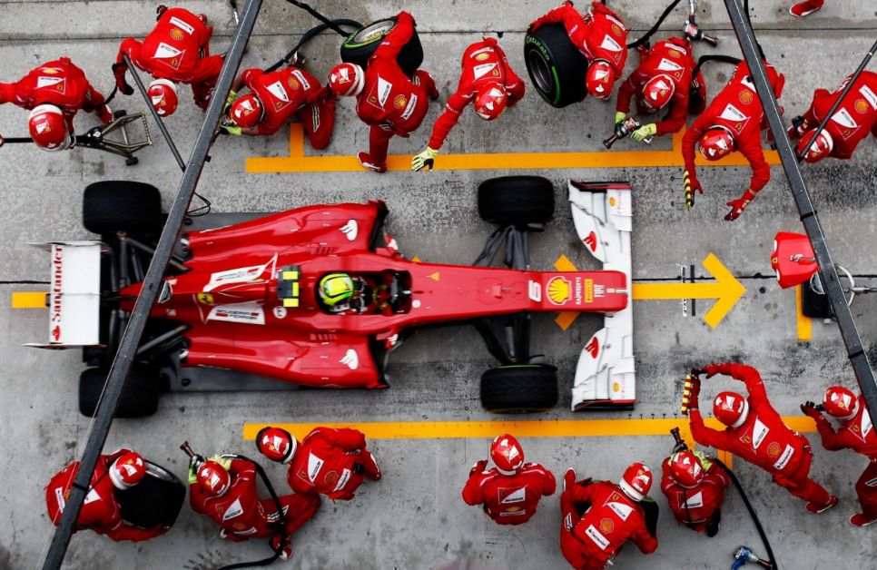
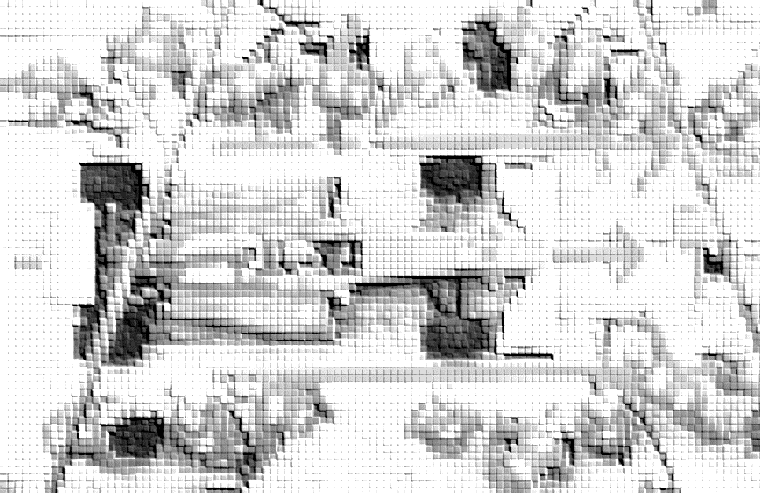
IT Execution: Expected team behaviours 2018>> F1 Pit stop Analogy
Expected Behaviors for Execution
Analogy of F1 Pit Stop
Speed and sense of urgency to drive high performance
High quality with no tolerance for errors.
Everyone knows what they are doing
Teamwork with Trust working environment
Team can be as fast as the slowest one

Slide 19



IT Execution: Internal Focus of 2018
Excellence in Execution:
Execution with right capability, mindset and expertise
Sense of Urgency with Can-do Attitude
Highly Engaging Team
Excited to generate new ideas
Default to “Yes”
Quality Assurance with zero tolerance for error
Acknowledge Strengths and Weakness
Establish development
Trust and Respects
Open Discussion
Network of sharing

Slide 20
THANK YOU

